Slide 1
ELEMENTARY STATISTICS, BLUMAN
TI Calculator - Normal Probability (2 of 3)
© 2019 McGraw-Hill Education. All rights reserved. Authorized only for instructor use in the classroom. No reproduction or further distribution permitted without the prior written consent of McGraw-Hill Education.

Slide 2
Objectives for this PowerPoint
How to use the TI Graphing Calculator to find a probability associated with a normally distributed random variable

Slide 3

Problem
The Bureau of Labor Statistics reported in 2016 that the mean hourly wage for registered nurses in the US was $34.70. Assume that nursing salaries are normally distributed with a standard deviation of $11.58. If a registered nurse is selected at random, what is the probability that he or she has an hourly wage that exceeds $54.62?
P(x > 54.62)
$$z=\frac{x−μ}{σ}=\frac{54.62−34.70}{11.58}=1.72$$
$$P\left(z>1.72\right)=1−0.9573$$
$$P\left(z>1.72\right)=0.0427$$

Slide 4
TI Calculator (1)
We have calculated z scores and then using the normal distribution table determined that this probability would 0.0427.
Now let's see how the TI graphing calculator can be used to arrive at the same result.

Slide 5
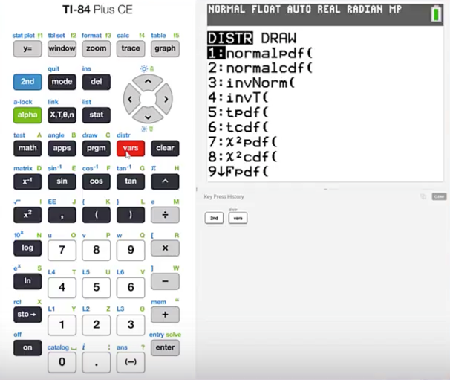
TI Calculator (2)
Press 2nd vars
We are going to use the normalcdf function.
Press 2

Slide 6
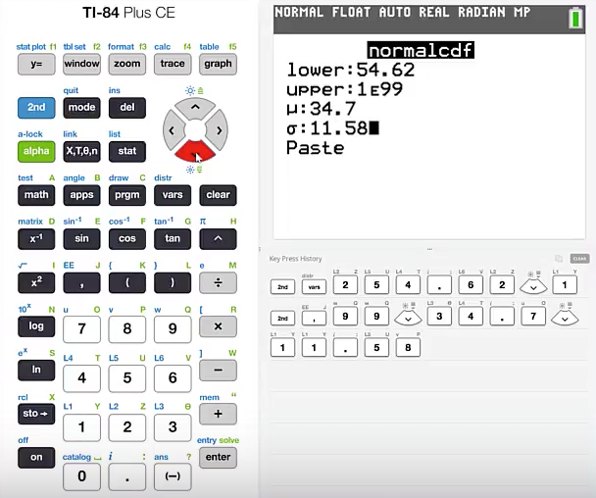
TI Calculator (3)
We are looking for the area to the right of a given value. So our x limit will be 54.62.
Cursor down for the upper limit
type 1 2nd and then the comma button
Press 99 The mean is 34.7 The standard deviation is 11.58
Highlight paste and press enter

Slide 7
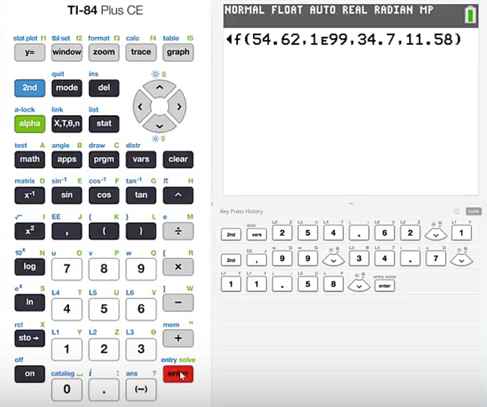
TI Calculator (4)
If you are using a TI graphing calculator that does not present a prompt for entering the required values, then you will need to place the values in order.
That order will be lower limit, upper limit, mean, and then standard deviation.
Press enter

Slide 8
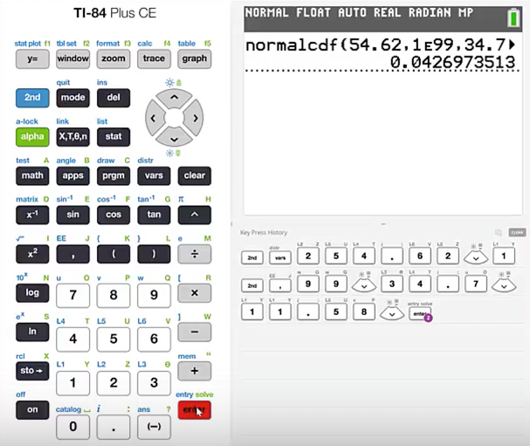
TI Calculator (5)
The calculator has determined that this probability would be 0.0427.
This agrees with the probability that was determined using the normal probability table.

Slide 9
Summary
In this PowerPoint, we learned how to use the TI Graphing Calculator to find a probability associated with a normally distributed random variable.

